Slide 1
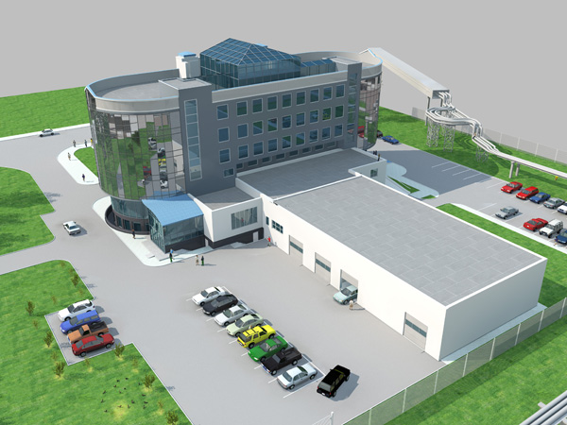
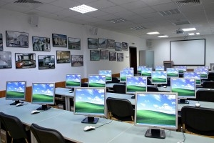
Moskow region
Project for cooperation with partners

Slide 2
The program
The INFLUX
With in the framework of cooperation with Moscow Domodedovo International airport was created the joint project, which was built by the educational terminal
MODEL
Public-private partnership of the region's businesses and educational institutions

Slide 3
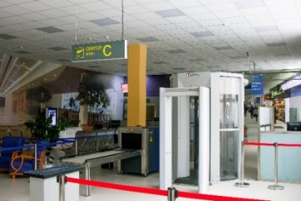
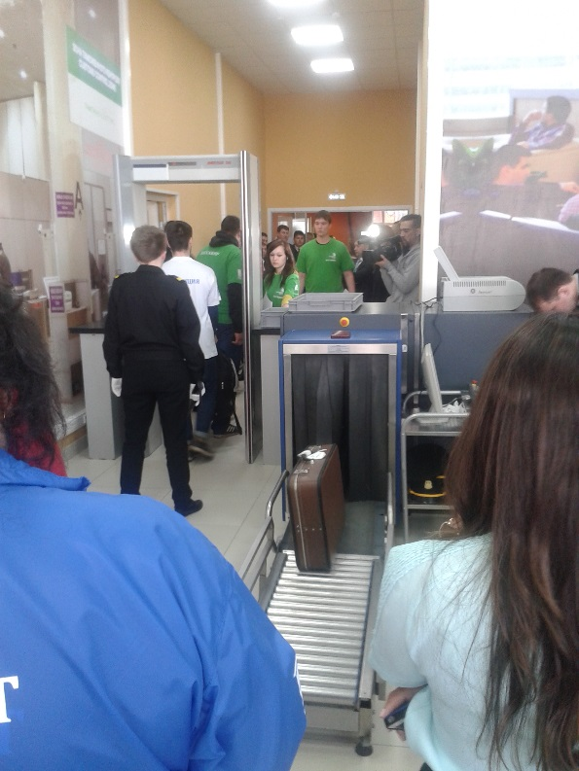
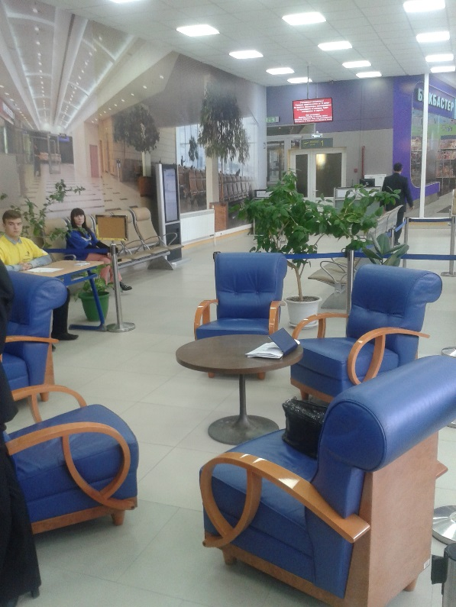
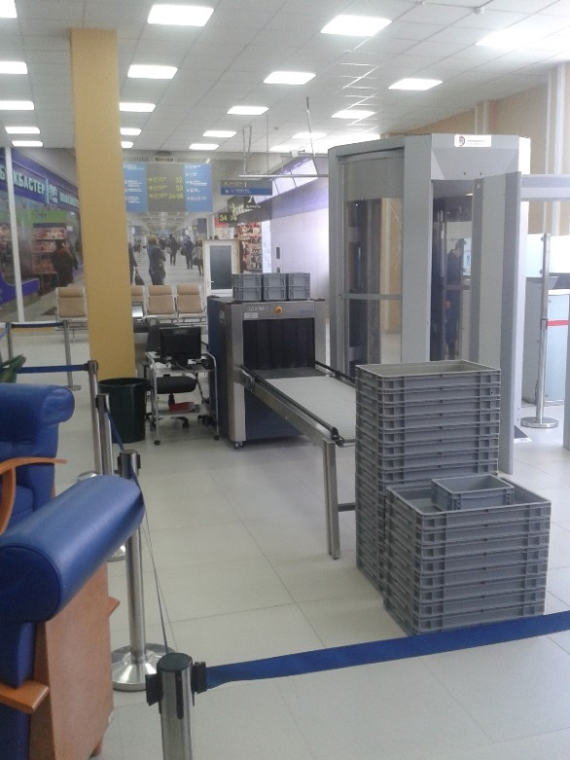
Educational Terminal
“Education terminal" is the leading base of the Moscow region for training of highly qualified personnel for the largest international airport Domodedovo
The center provides the necessary conditions for the successful preparation of students in two areas of the specialty “Services on air transport”:
Agent registration
Inspector aviation safety

Slide 4
The main problems of this project
The need of the employer
Funding
Repair, purchase and installation of training simulators

Slide 6
EXPERIENCE
Project
Business skills
Plan
To organize
Exchange of experience

Slide 7
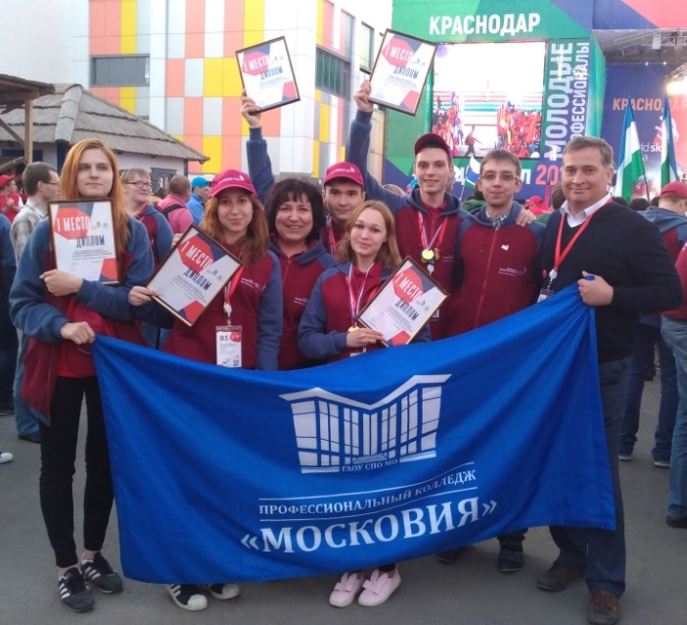
The First place in the Championship of Russia on competences: “Service on air transport”
The RESULT
The recruitment of younghighly qualified personnel

Slide 8
Thank
you for your attention

